Slide 1
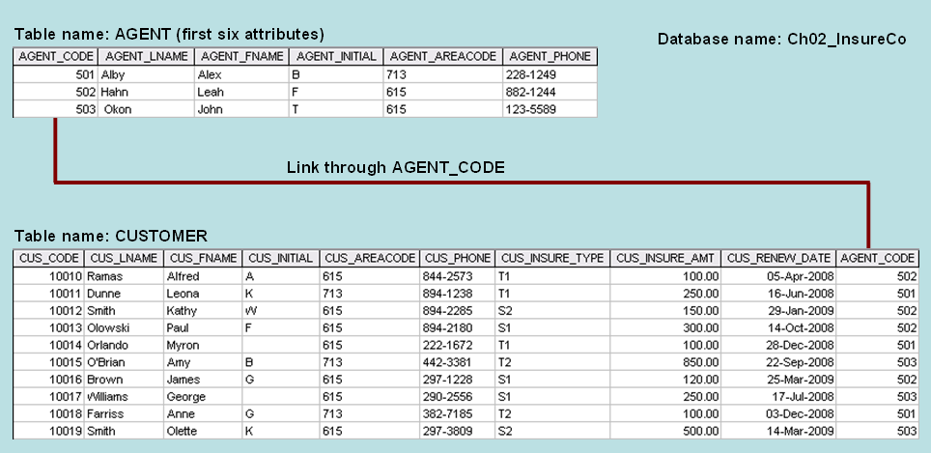
Chapter 2 - Class Exercise Solution - The Tables

Slide 2
Chapter 2 - Class Exercise Solution Question 1 – The business rules
One agent can have many customers.
Each customer has only one agent.
Note:
1. Always state both sides of the relationship
2. Given these business rules, you can conclude that there is a 1:M relationship between AGENT and CUSTOMER

Slide 3
Chapter 2 - Class Exercise Solution Question 2 – The ERDs
Crow’s Foot
Chen

Slide 4
Chapter 2 - Class Exercise Solution Question 3 – The Object Model
AGENT
1
CUSTOMER
M

Slide 5
Chapter 2 - Class Exercise Solution Question 3 – The UML Model
AGENT
CUSTOMER
+ can have
+ Associated with
1 .. 1
0.. *
An Agent can have Zero or more customers
A Customer is associated with one and only one Agent

